Slide 1


CURA-HMS
CURA

Slide 2

AGENDA

Slide 3
AGENDA
Improvements from Professor Feedback
Problem Statement
Project description
Team Aggrement
Personas
Sprint 5 Recap
Architecture Diagram
Technologies
Algorithms
Product Backlog
Sprint Backlog
Metrics
Retrospective
Sprint 6
Project demo
Live Application
Architecture Diagram
Sprint 2 Recap
Product Backlog
Sprint Backlog
Metrics
Retrospective
Sprint 4
CURA

Slide 4
Improvements FROM PROFESSOR FEEDBACK
Feedback
Improvements
Story Points Missing.
Mention Diagram name.
Make theme consistent .
Title for every slide and manage color coordination.
Mention sprint number in sprint backlog.
Remove place column from user stories and acceptance criteria.
Sprint backlog should have story points.
Edit burndown charts, it should have only completed stories.
Story points mentioned to every user story.
Mentioned diagram name.
Maintained theme consistency and color coordination.
Architectural Diagram mentioned.
Mentioned sprint number in sprint backlog.
Removed place column from user stories and acceptance criteria.
Added story points to sprint backlog.
Edited burndown charts with completed stories.

Slide 5


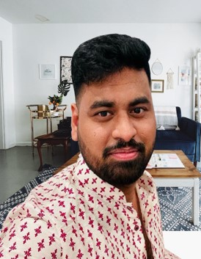
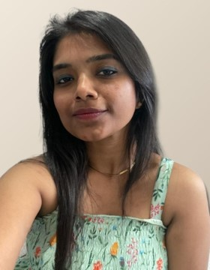
MEET OUR TEAM
SAI TEJA KORIBILLI
SCRUM MASTER
DATA BASE ADMINISTRATOR
BINDU VALISETTY
UI/UX DEVELOPER
KULDEEP KALUVALA
DEVELOPER
MOUNIKA THALLA
PROJECT MANAGER

Slide 6
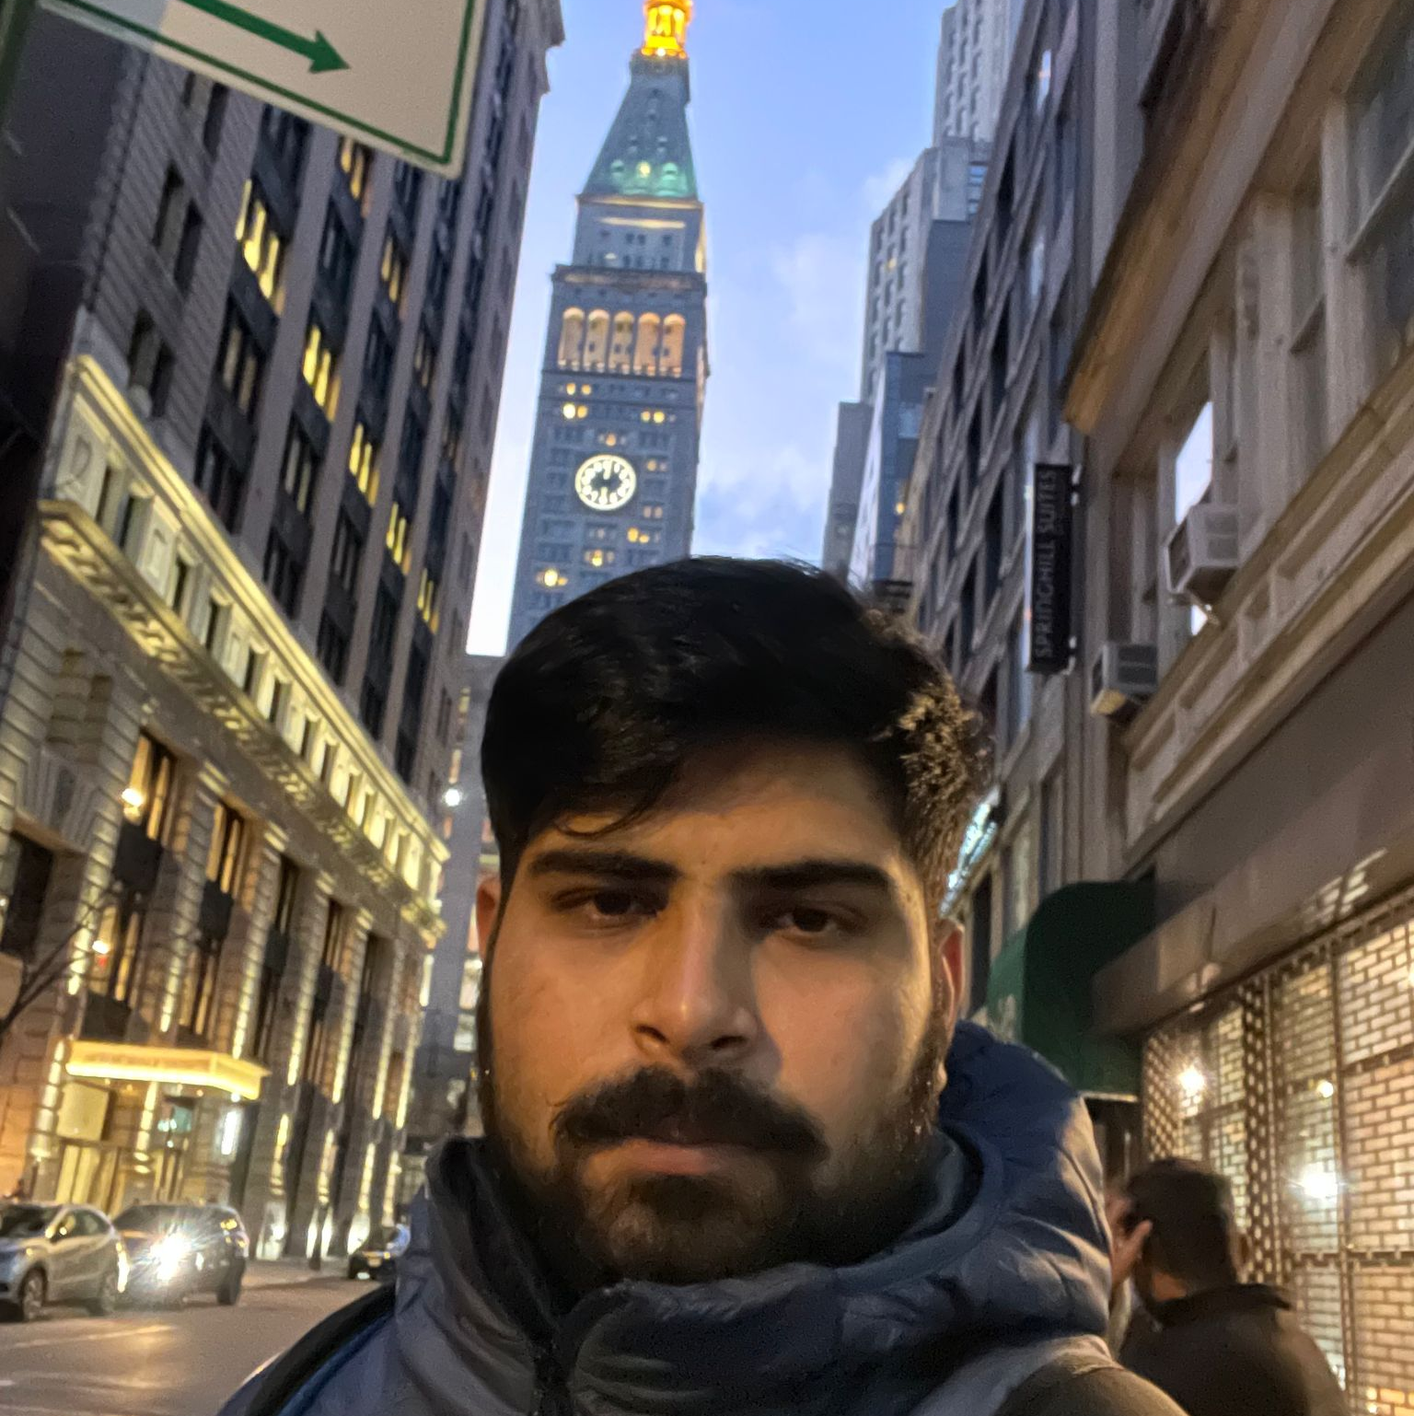


MEET OUR TEAM
SHIVANSH TOMAR
DEVELOPER
JIGAR SHAH
DEVELOPER
NIKHIL
QUALITY ANALYST ENGINEER

Slide 7
PROBLEM STATEMENT
Most hospitals are still facing several challenges with Hospital Management System because some of them are still using manual processes, while those who are using computerized method are also facing the challenge of adjusting to it. Like:
The high cost of software development and deployment.
Complex design in terms of User Interface and User Experience (UI/UX Design)
Fear of data security breach.
Difficulty in migrating from manual processes, because both staff and patients are used to the manual processes and so are unable to speedily cope with the new system.
Lack of IT-friendly medical personnel is also presenting several challenges.
A Huge influx of patients visiting government hospitals makes the process of migrating to automated processes highly difficult. They do not have the patience to wait for registration and data entry and often fail to understand the functioning of automated processes.

Slide 8
PROJECT description
CURA helps to automate routine tasks, optimize staff coordination, improve communication, distribute the workload, store different types of information, and provide financial and HR management.
A hospital management system (HMS) is a tool that collects data about patients, doctors, staff, hospital administrative details in one software. One of the biggest advantages of developing a hospital management system is that it makes the whole process paperless.
Finances are another essential side of the hospitals. Apart from administrative, operational, and medical services, healthcare units must cope with billing and insurance operations. Integrating a financial system into a medical organization is vital for its sustainable financial performance.

Slide 9

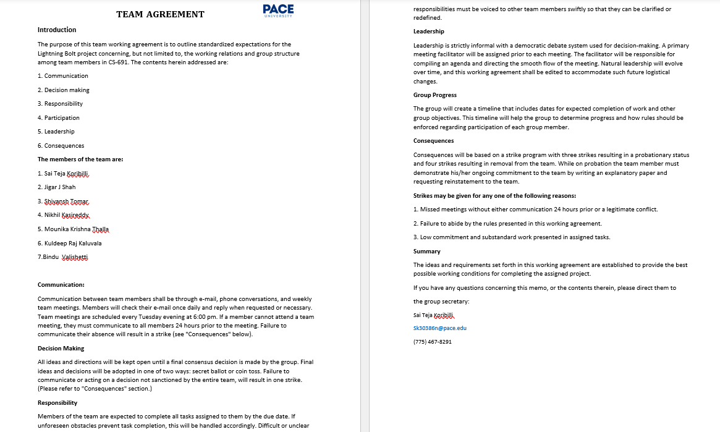

Team working aggrement

Slide 10


Personas
CURA

Slide 11
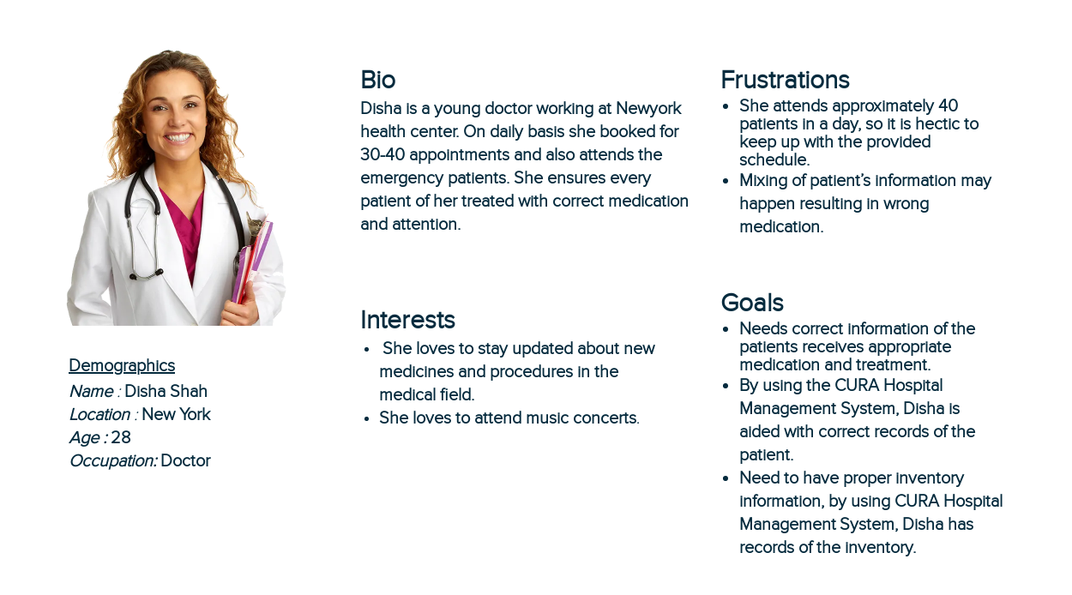
Persona 1

Slide 12
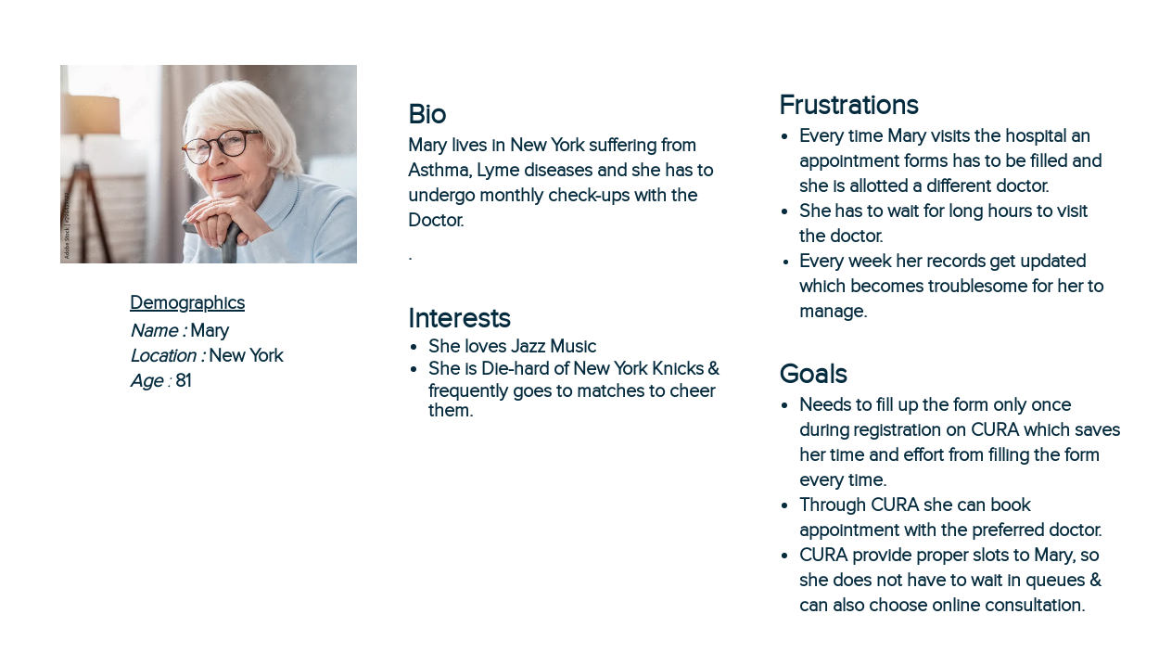
Persona 2

Slide 13
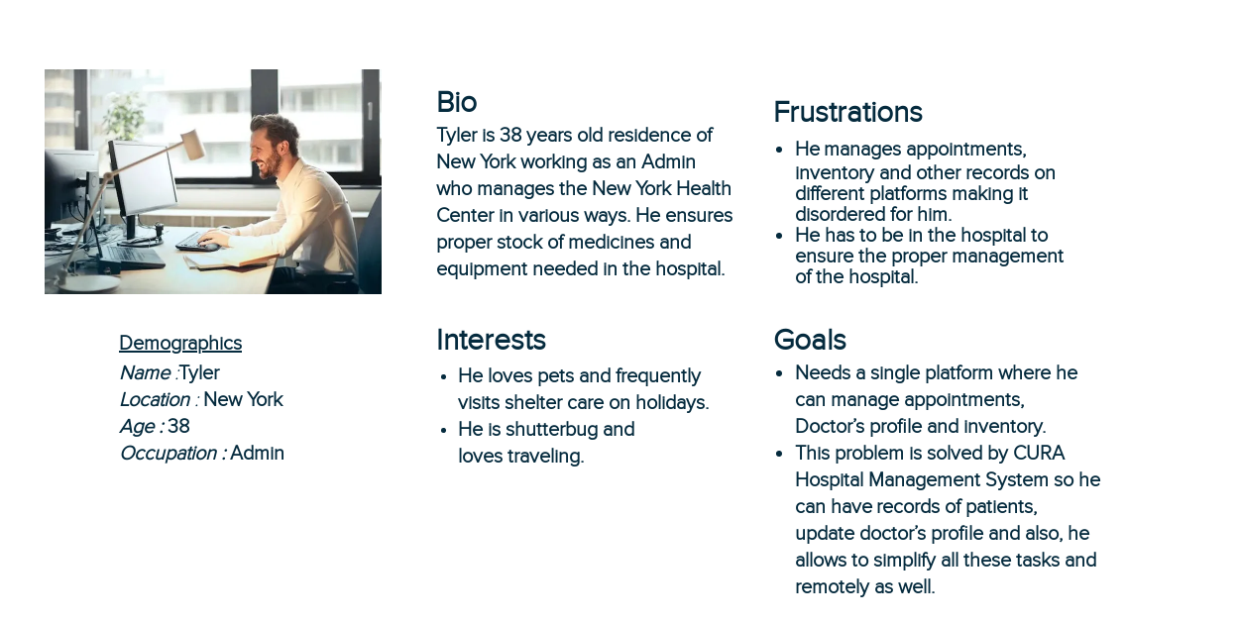
Persona 3

Slide 14

Minimum viable product
REGISTRATION
User can register into CURA through this
LOGIN PAGE
User can log into CURA through this
HOME
User can surf through CURA features through this
User can plan his schedule using this and work accordingly
APPOINTMENTS
SCHEDULING
User can schedule his appointment with doctor through this

Slide 15








technologies
JAVA SCRIPT
GIT HUB

Slide 16
ALGORITHM
The proposed system has five modules for doctors, admin, pathologist, inventor and patients providing facilities of appointments schedules, payment, viewing online information, register on hospital website. The whole process of information sharing and processing in this systems is automated through Decision Tree ID3 algorithm
What is ID3 Algorithm ?
ID3 stands for Iterative Dichotomiser 3 and is named such because the algorithm iteratively (repeatedly) dichotomizes(divides) features into two or more groups at each step.
ID3 uses a top-down greedy approach to build a decision tree. In simple words, the top-down approach means that we start building the tree from the top and the greedy approach means that at each iteration we select the best feature at the present moment to create a node. Attempts to create the smallest possible decision tree.

Slide 17

ArchitecturAL Diagram
CURA

Slide 18
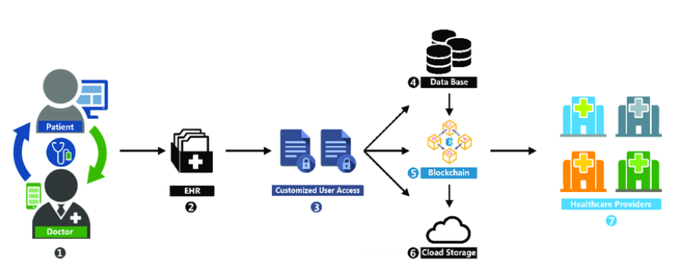
CONCEPTUAL ARCHITECTURAL DIAGRAM

Slide 19
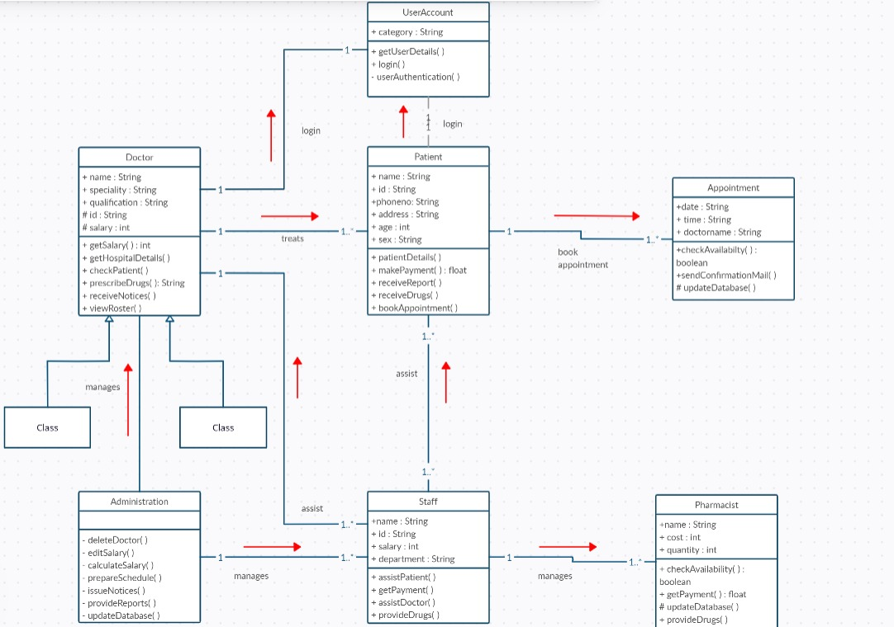
CLASS DIAGRAM

Slide 20
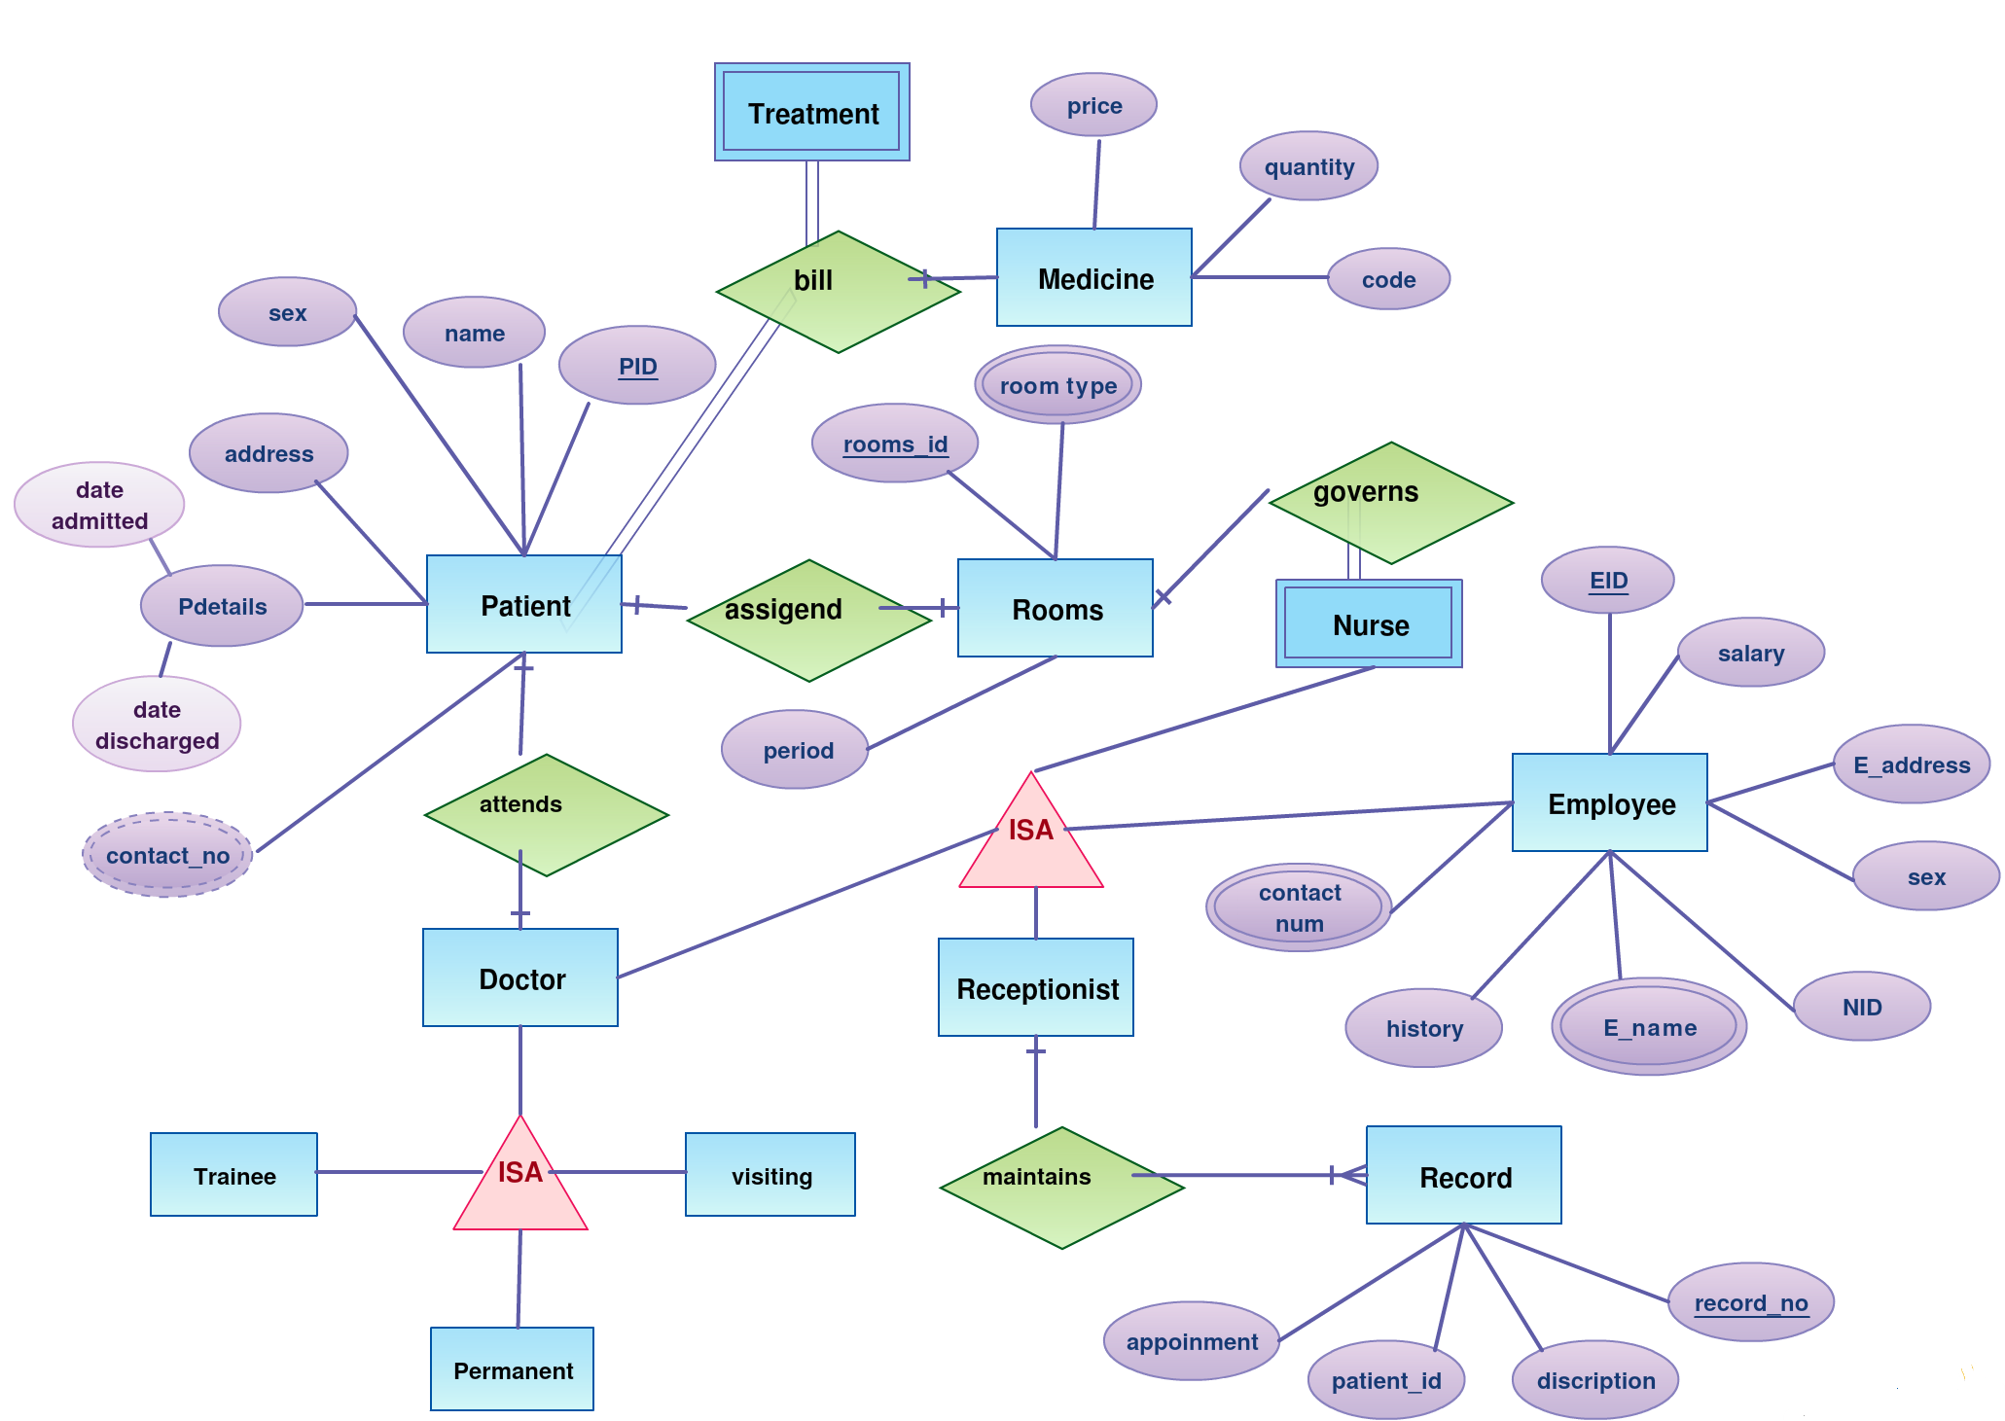
ER DIAGRAM

Slide 21
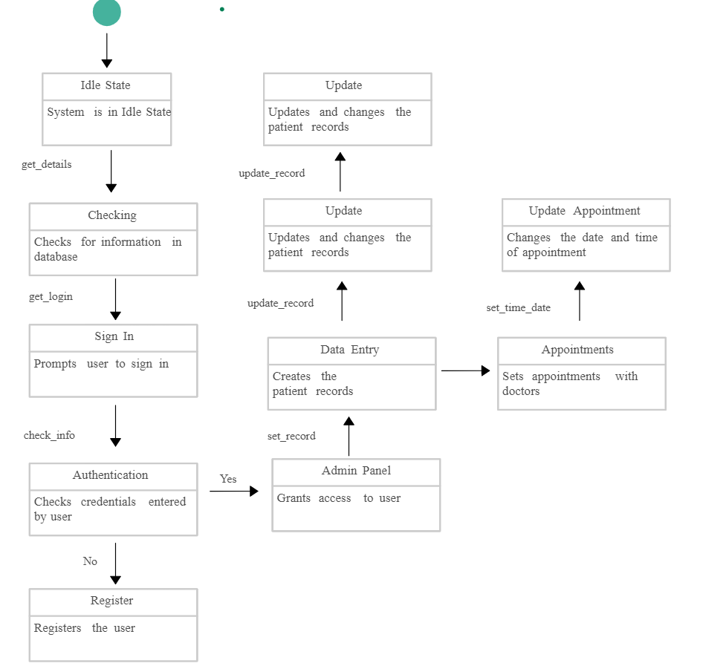
STATE DIAGRAM

Slide 22
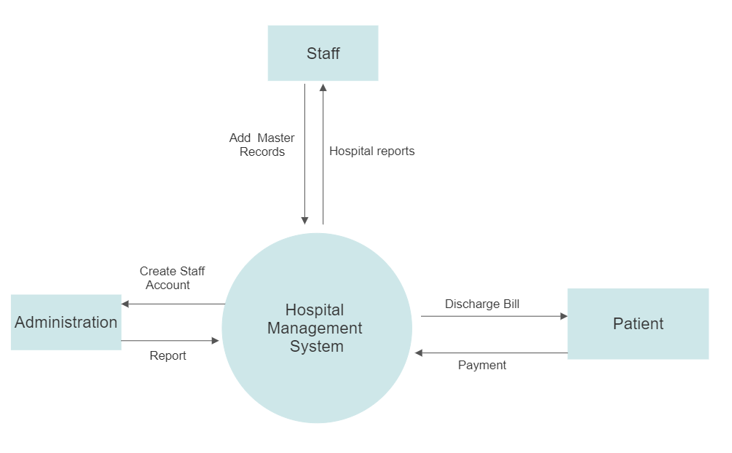
DATAFLOW DIAGRAM LEVEL 0

Slide 23
SPRINT4 RECAP
SCHEDULE
Multiple features like add data
Created Proper UI

Slide 24
SPRINT 4 VS SPRINT 5
SPRINT 4
SPRINT 5
SCHDULING THE APPOINTMENTS.
MULTIPLE FEATURES LIKE ADDING DATA.
CREATED PROPER UI ALONG WITH UPDATING THE FEATURES TO THE RESPECTIVE ROLES ACCORDINGLY.
SURFING THROUGH THE OPTIONS ACOORDING TO THE ROLE OF THE PERSON USING THE APPLICATION.
UPDATING THE CURRENT PROFILE STATUS BY UPLAODING FILES.

Slide 25

PRODUCT BACKLOG

Slide 26
PRODUCT BACKLOG
Issue Type | ID | Name
Story | CURA-29 | As a Doctor, I want to see my particulars/schedule/profile on the application so that I can plan my duties at hospital .
Story | CURA-30 | As a Patient, I want to confirm whether my appointment with the doctor is set up or no so that I can have an idea about my appointment with doctor.
Story | CURA-31 | As a Patient, I want to submit my symptoms/previous history documents in the portal for assessment so that I may receive a accurate determination.
Story | CURA-32 | As an Inventor, I want to know whether the supplies are as per the requirement or no, so that I can re-stock them.
Story | CURA-33 | As a Pathologist, I want to know whether samples of the patient are correctly entered or no, so that there is no confusion with patient's details with others.
Story | CURA-34 | As an Admin, I want to navigate to doctor/staff/nurse section to check the log-in time so that I can verify whether every doctor/nurse/staff is attending the hospital on time.
Story | CURA-36 | As a Staff, I want to check room availability and manage rooms according to requirement so that it will be very helpful to doctors.
Story | CURA-37 | As a Patient, I want to registers patient's for admittance to the hospital.
Story | CURA-38 | As a Patient, I want to manages patient financial operations, including billing and insurance.
Story | CURA-39 | As a Staff, I want to know the ward management which helps caregivers plan, track, and manage the various departments in the hospital so that it will very helpful to patients.

Slide 27
Sprint BACKLOG

Slide 28
Sprint BACKLOG 5
Issue Type | Key | Name | Story Points Estimate
Story | CURA - 39 | As a patient, I want to able to search on the app, so that I can find the necessary information . | 3
Story | CURA - 40 | As a patient, I want to update my profile and also upload reports so that doctor can know the patient condition. | 3
Story | CURA - 41 | As an admin, I want to see all the doctor's list in the application so that, I can manage the system according to my need. | 3

Slide 29

USER STORIES AND ACCEPTANCE CRITERIA

Slide 30
User Stories & Acceptance Criteria
User Story ID | Summary | Story Points
CURA-29 | As a Doctor, I want to see my particulars/schedule/profile on the application so that I can plan my duties at hospital . | 3
 | Scenario : Doctor wants to check his schedule Given I logged as Doctor When I open the application then as a doctor see the appointment details per day/week/month and also see the details of the patients .
CURA-30 | As a Patient, I want to confirm whether my appointment with the doctor is set up or no so that I can have an idea about my appointment with doctor | 3
 | Scenario : Patient wants to check with his appointment details Given I logged as Patient When I open the application and go to this page then see my appointment details with the doctor and I plan accordingly.
CURA-31 | As a Patient, I want to submit my symptoms/previous history documents in the portal for assessment so that I may receive a accurate determination | 3
 | Scenario : Patient wants to upload his previous history documents & symptoms Given I logged as Patient When I open the application and go to this page then see the browse option for uploading the documents and see the page to enter the details of my previous history & symptoms.
CURA-32 | As an Inventor, I want to know whether the supplies are as per the requirement or no, so that I can re-stock them. | 3
 | Scenario : Inventor wants to see the list of stock Given I'm in a role of Inventor or logged-in inventor When I open the web application then see the inventory supply details page, clicking on the page I should be able to see all the inventory details and option to restock
CURA

Slide 31
User Stories & Acceptance Criteria
User Story ID | Summary | Story Points
CURA-33 | As a Pathologist, I want to know whether samples of the patient are correctly entered or no, so that there is no confusion with patient's details with others. | 3
 | Scenario : Pathologist wants to check patient's samples Given I am in a role of logged-in Pathologist When I open web-application and go to this page then verify the patient's samples entered correctly or not
CURA-34 | As an Admin, I want to navigate to doctor/staff/nurse section to check the log-in time so that I can verify whether every doctor/nurse/staff is attending the hospital on time. | 3
 | Scenario: Admin wants to check the login & log-out time of hospital staff Given I logged as Admin When I open the portal then in the system I can check total hour a doctor/staff/nurse spends on seeing patients and also verify doctor/staff/nurse time.
CURA-35 | As a Staff, I want to check room availability and manage rooms according to requirement so that it will be very helpful to doctors. | 3
 | Scenario: Staff wants to check availability of rooms at hospital Given I am in role of logged-in staff When I open the portal then click on this page so I can able to verify availability rooms and manage them.
CURA-36 | As a Patient, I want to registers patient's for admittance to the hospital. | 3
 | Scenario: Patient wants to easy way for registration Given I am in role of logged-in patient When I open application for first time then I see a link as Register Now then clicking on the link redirects to the registration form page and it will be very easy for patients to register in application.
CURA

Slide 32
User Story ID | Summary | Story Points
CURA-37 | As a Patient, I want to manages patient financial operations, including billing and insurance. | 3
 | Scenario : Patient wants to know about financial operations & insurance policies Given I am in role of logged-in patient When I open the application I will be able to see all plans included then I able to should select my insurance plan and also have other related financial operations
CURA-38 | As a Staff, I want to know the ward management which helps caregivers plan, track, and manage the various departments in the hospital so that it will very helpful to patients. | 3
 | Scenario : Staff wants to know caregivers plan in hospital Given I am in role of logged-in staff When I open the application then click on this page I can able to verify plans and able to track them. .
User Stories & Acceptance Criteria
CURA

Slide 33
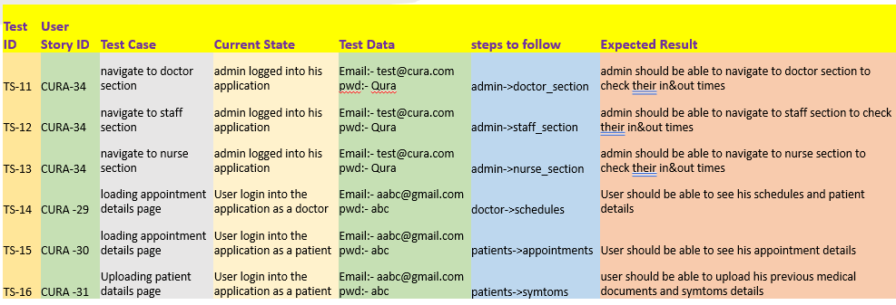
TEST CASES

Slide 34
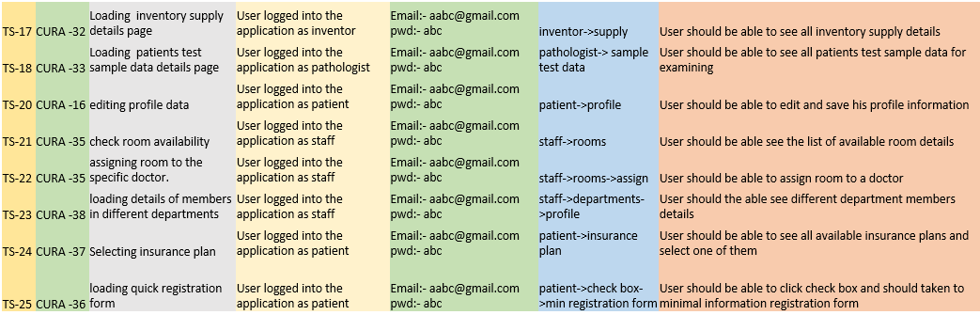
TEST CASES

Slide 35
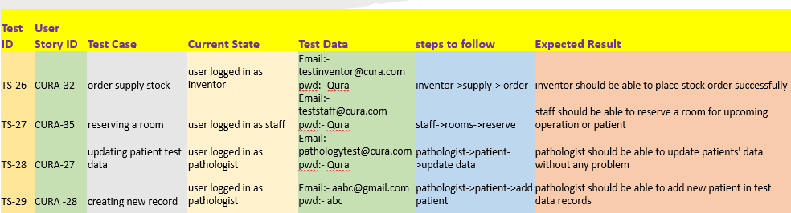
TEST CASES

Slide 36
stories Completed and not Completed
Issue Type | Key | Name | Story status
Story | CURA - 39 | As a patient, I want to able to search on the app, so that I can find the necessary information . | Completed
Story | CURA - 40 | As a patient, I want to update my profile and also upload reports so that doctor can know the patient condition. | Completed
Story | CURA - 41 | As an admin, I want to see all the doctor's list in the application so that, I can manage the system according to my need. | Completed

Slide 37
METRICS
CURA

Slide 38
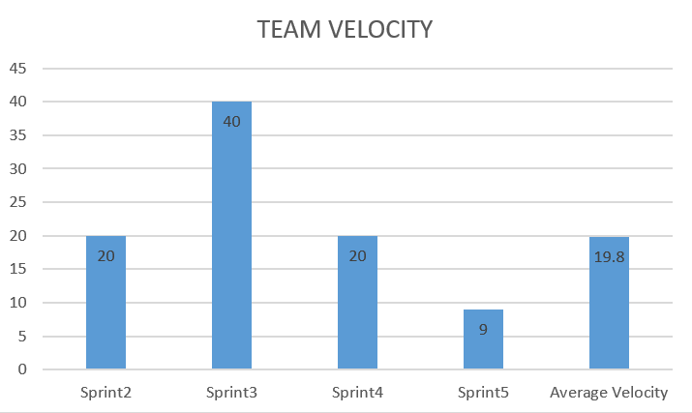

Slide 39
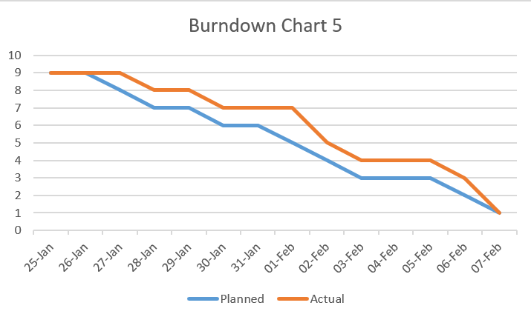

Slide 40
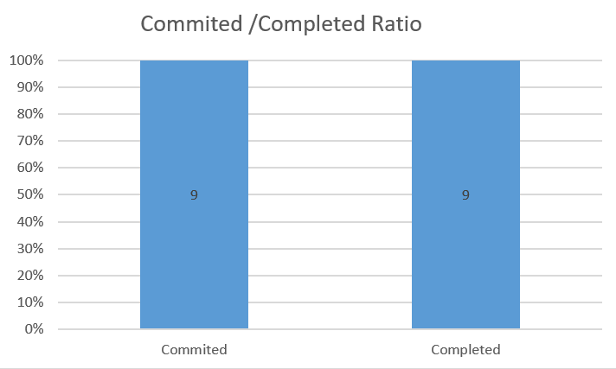

Slide 41
Retrospectives
What went well??
What didn't went well??
What next??
Team completed the task before due date.
Team mates participates actively in team meeting calls
Avoid delaying work
Facing difficulty in implementation part
Team members need to interact more in group meeting
Set small targets to complete task more efficiently

Slide 42

Sprint 6

Slide 43
Stories planned for Sprint 6
Issue Type | Key | Name | Status | Story Points Estimate
Story | CURA - 42 | As a pathologist I should be able to see the medication given to the patient previously so , when new medicines are prescribed to the patient the old prescription is updated. | To Do | 3
Story | CURA - 43 | As a patient, I want to able to download the prescriptions for future purpose. | To Do | 3
Story | CURA - 44 | As an admin, I want to check the login and log out time of all Doctors/Staff/Inventors etc. | To Do | 3

Slide 44
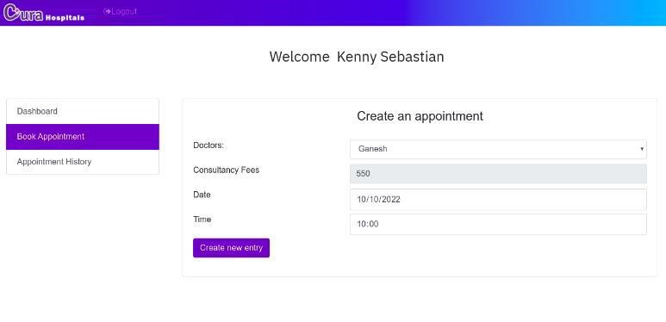
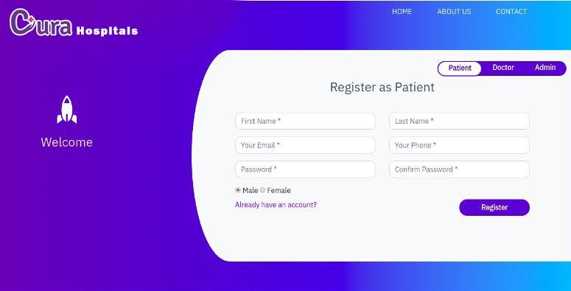

Slide 45

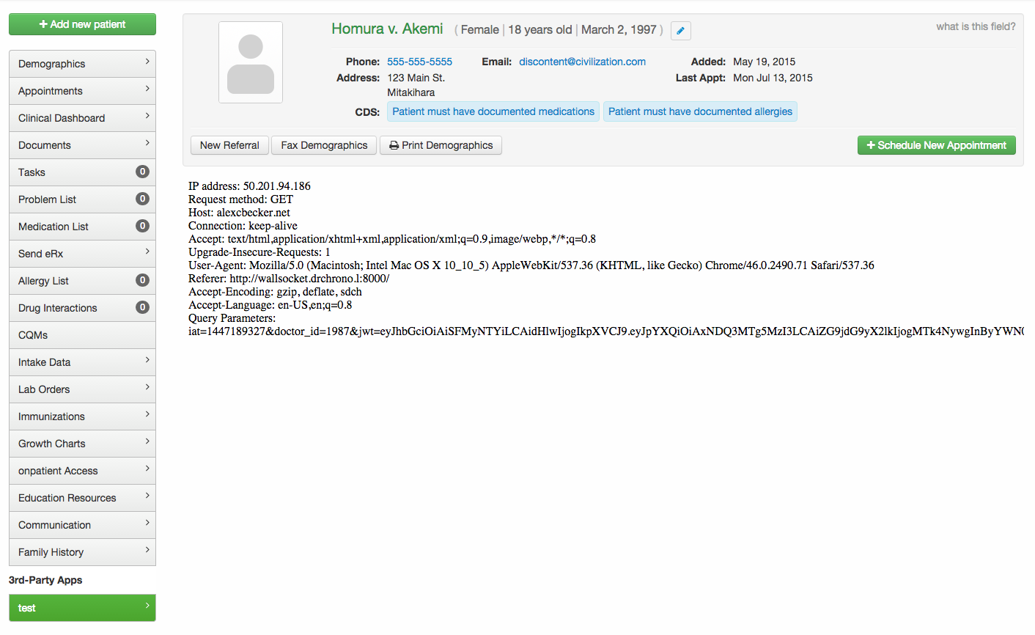


Slide 46
GITHUB LINK
https://github.com/SaiTejjj/HMS/wiki/CURA---HMS

Slide 47
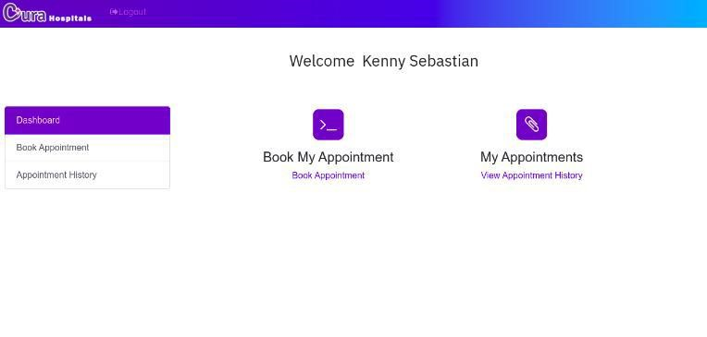
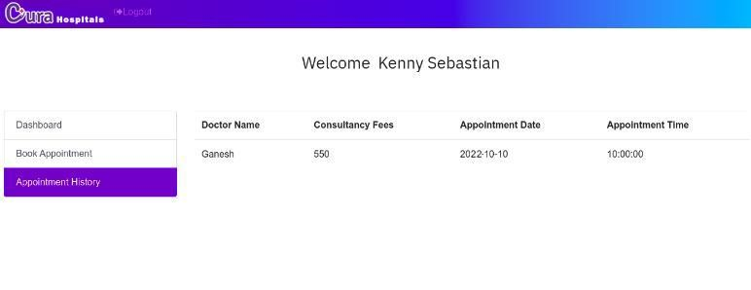
Live application demo
CURA

Slide 48

THANK YOU
Sai Teja Koribilli
Jigar Shah
Mounika Thalla
Kuldeep Raj
Bindu Valishetti
Nikhil
Shivansh Tomar

